Slide 1


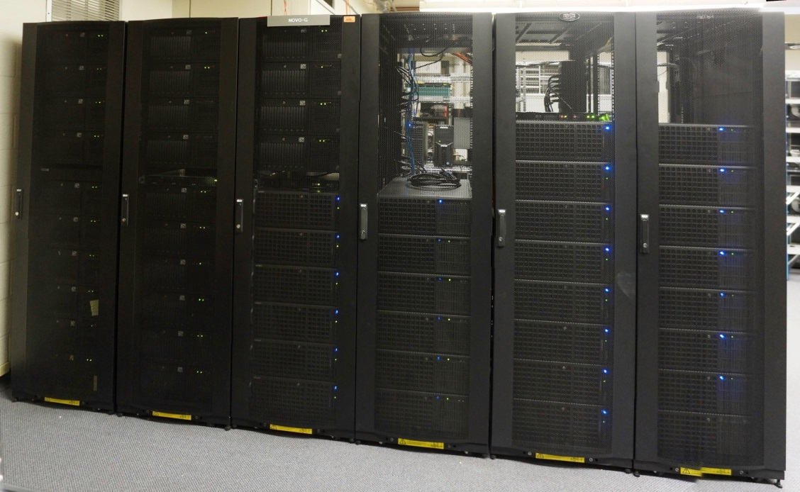
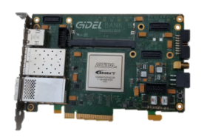
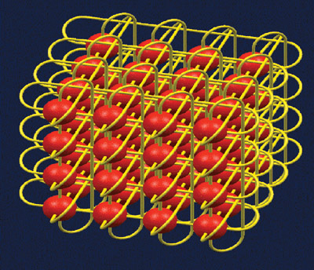
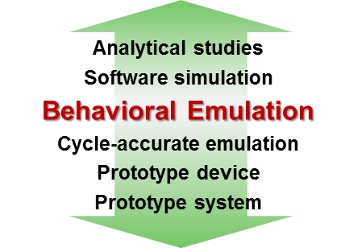
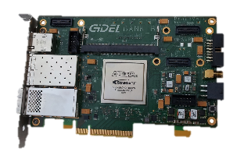
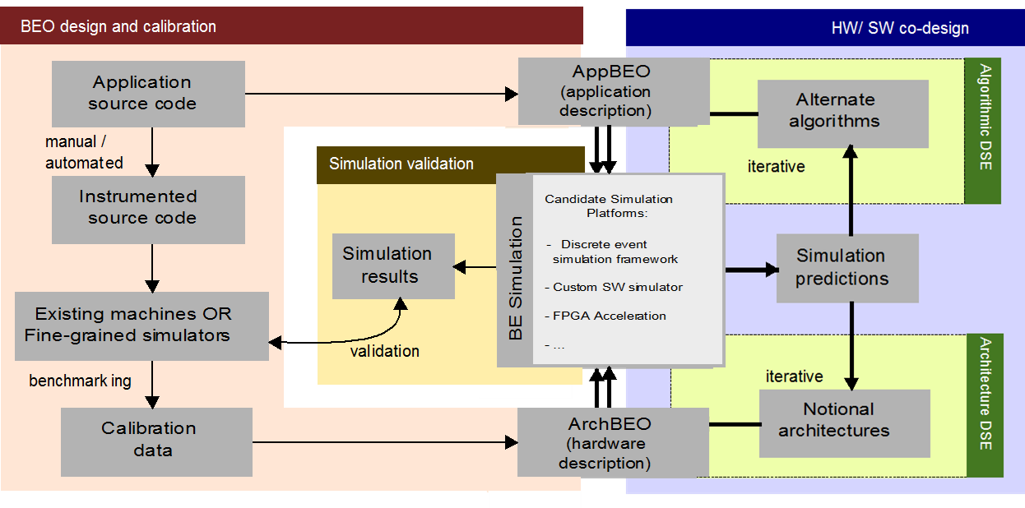
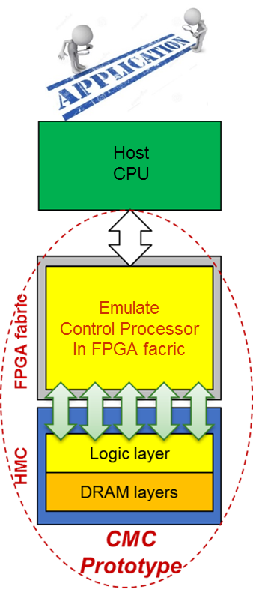
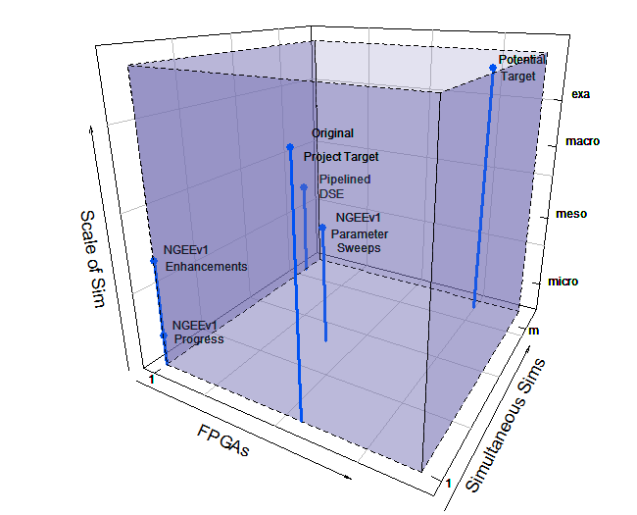
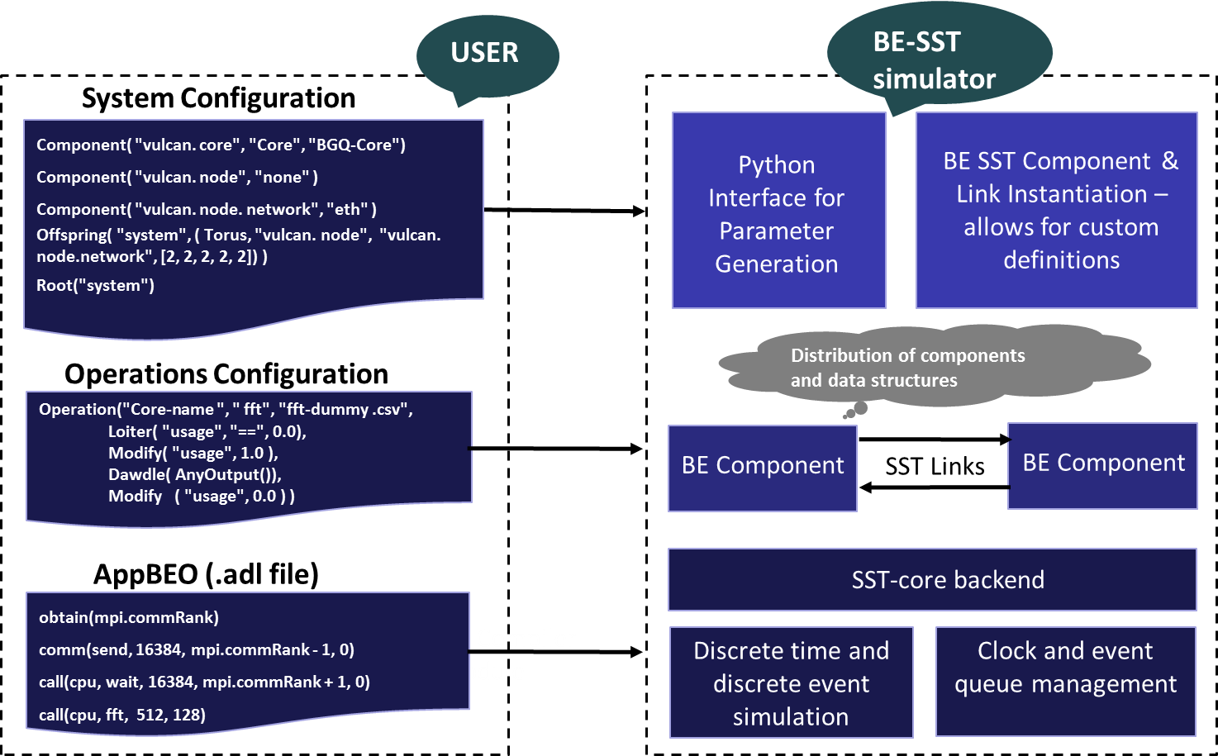
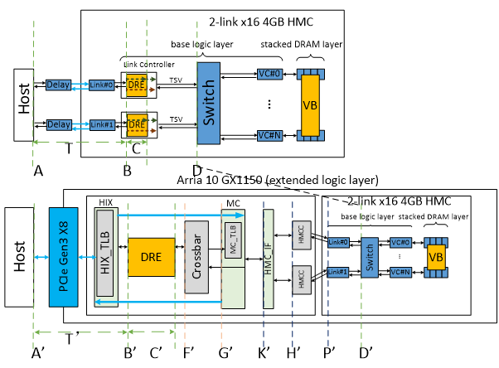
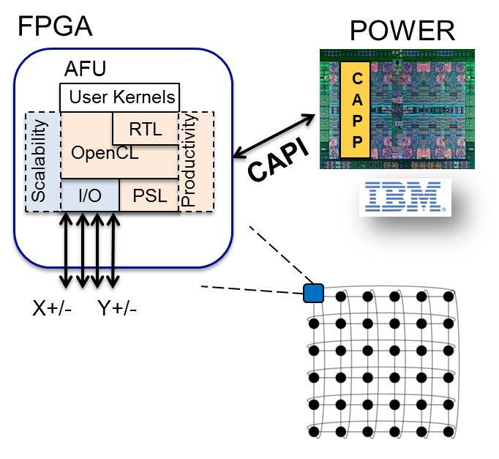
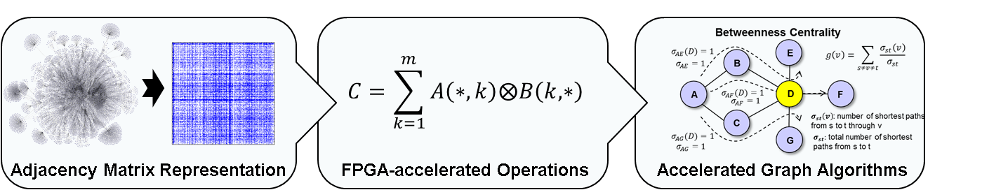
App & Architecture Studies
In Reconfigurable Supercomputing (RSC)
Novo-G# Reconfigurable Supercomputer
52+1 Linux servers
448 FPGAs (+ 64 coming soon)
192 Altera Stratix-III E260 FPGAs
192 Altera Stratix-IV E530 FPGAs
64 Altera Stratix-V D8 FPGAs
Reconfigurable interconnect
3D (4x4x4) Torus or 6D Hypercube
64 Altera Stratix-V D8 FPGAs (coming soon)
Reconfigurable Interconnects
Goal
Node Architecture
Goal: Low-power, high-connectivity RC platform
Targeted towards large-scale, communication-intensive problems like MD* & CFD**
ctrl logic
X
P
H
Y
P
H
Y
X
C
App kernel
C
V
V
R
R
X
Approach:
Novo-G# network design to support multi-FPGA apps efficiently
Reconfigurable networking to adapt protocol & topology to needs of target application
OpenCL support to improve productivity & usability
X
Approach
C
P
H
Y
App kernel
P
H
Y
C
V
V
R
R
X
P
H
Y
P
H
Y
X
C
OpenCL channels
C
V
V
R
OpenCL
Router
R
…
…
Inter-FPGA links
FPGA
Inter-FPGA links
X
P
H
Y
App kernel
P
H
Y
X
C
C
V
V
R
R
Outcomes
X
P
H
Y
Bypass kernel
P
H
Y
X
Outcomes:
Flexible 3-layer protocol stack for Novo-G#
Supports multiple protocols from light-weight to feature-rich
Novo-G# provides high-speed, reliable connectivity
Bit error rate < 10⁻¹³ for each 10 Gbps link
Support for Altera OpenCL on multiple FPGAs
Inter-FPGA links abstracted to inter-kernel (I/O) channels
Reconfigurable network support to fit architecture to app
End-to-end AOCL-based design flow with DSE emphasized
C
C
V
V
R
Behavioral Emulation
R
Goal & Motivation
Novo-G#
64 GiDEL ProceV (Stratix V D8)
4x4x4 3D torus
6 Rx-Tx links/FPGA
4x10 Gbps per link
How to study future notional devices, nodes, & systems, up to Exascale without an existing Exascale system?
Approach
*MD = Molecular Dynamics **CFD = Computational Fluid Dynamics
ProceV Board
Manage emulation complexity via Behavioral Emulation (BE)
Coarse-grained, multi-scale simulation approach to balance accuracy, speed, & scalability
CMC Research Platform
NGEE** BE Platform
Motivation
Memory-intensive Big Data apps: memory bottleneck & high energy consumption
HMC: higher B/W & lower power than conventional memories
Potential for C-RAM* & PIM** processing (CMC)
Goal
Scale of Sim
Create research platform for design space exploration of CMC apps & arch before existence of CMC
Simultaneous Sim
Approach
SST*-based BE Platform
*SST: Structural Simulation Toolkit, Sandia National Lab
FPGAs
Explore performance measurement methods for CMC platform
Research performance modelling for notional CMC architecture
Initial case study CMC app: DRE*** of LLNL
Experimental Testbed will:
Support algorithmic design-space exploration
Provide behavioral emulation within SST* ecosystem
Original Project Target: One large, Exascale simulation distributed over many FPGAs
NGEEv1** Progress: One small, microscale simulation limited to a single FPGA
NGEEv1 Enhancements: Ongoing improve-ments to allow for simulations at larger scale
NGEEv1 Parameter Sweeps: Multi-FPGA DSE⁺ limited to a single simulation per device
Pipelined Design-Space Exploration: Simultaneous simulations pipelined in 1 FPGA
Up to eight orders-of-magnitude faster DSE/UQ than software simulator
Potential Target: Multiple Exascale simulations simultaneously distributed over many FPGAs
Model of notional CMC*
Progress
Initial prototype of CMC research platform on Convey Merlin* board (FPGA + HMC)
Research performance modelling for notional CMC architecture
Merlin Board**
Explore performance measure. methods for CMC platform
Add hardware monitors to Merlin board infrastructure code
**NGEE: Novo-G Exascale Emulation
⁺DSE: Design-Space Exploration
⁺⁺UQ: Uncertainty Quantification
(hardware monitors)
* Nair, R., et al. "Active Memory Cube: A processing-in-memory architecture for exascale systems.“ IBM Journal of Research and Development 59.2/3 (2015): 17-1.
** Merlin board from Convey Computer, Inc. (now a part of Micron)
RSC for Big Data & Extreme Computing
Sparse-Matrix Processor for Graph Apps
Motivation
Goal
Large-scale, heterogeneous systems
A necessity for big data & extreme-scale computing (toward Exascale)
Develop Framework = Architecture + Tools
for FPGA accelerators
that is scalable and productive
Motivation
Goal
Traditional architectures poorly suited for sparsity of graph datasets
Develop scalable architecture to accelerate graph processing in the language of linear algebra
Approach
Architecture
Directly interconnected FPGAs
Provides performance & scalability through OpenCL pipes
Memory coherency
AFU uses CAPI to directly access host process memory
Tools
Hybrid programming model
Use high-level OpenCL language to increase designer productivity
Leverage optimized RTL cores (libraries)
DSE of large-scale heterog. systems
using system simulation tools (e.g., PSL Simulation Engine)
Approach
Outcomes
Develop custom architectures for distributed SpGEMM
Scale to multiple FPGAs leveraging Novo-G# interconnect
Developed graph-processor architecture on Stratix-IV E530
>200x performance-per-watt improvement over CPU for SpGEMM¹
Exploring amenable graph kernels & apps on our architecture
AFU: Accelerator Functional Unit
CAPI: Coherent Accelerator Processor Interface from IBM
CAPP: Coherent Accelerator Processor Proxy
PSL: POWER Service Layer
DSE: design space exploration
¹ SpGEMM – Sparse Generalized Matrix/Matrix Multiplication; SuiteSparse/CombBLAS baseline on Xeon E5260 @ 2.40 GHz

